Slide 1
PENN HIGH SCHOOL
Are you ready for high school?

Slide 2
Topics to Cover
Important Dates
Diploma Options
Testing
Choosing Classes
Tours
Questions & Answers with Mentors

Slide 3

Parent evening at your Middle School
SMS – Tuesday, Nov. 29– 6:00-7:00 p.m.
DMS – Wednesday, Nov. 30 – 6:00-7:00 p.m.
GMS – Thursday, Dec. 1– 6:00-7:00 p.m.
Penn Showcase
Monday, Dec. 12 – 6:30-8:00 p.m.
Tuesday, Dec. 13 – 6:30-8:00 p.m.
Choose 1 night to attend the Open House

Slide 4
Penn Academies
Freshman Academy
Achievement Academies
(grades 10-12)
Smaller Learning Community (Students typically share the same group of teachers for English, Math, Biology & Geography (called houses).
The teachers within a house often collaborate on assignments, plan field trips/community service projects, and discuss students in need of additional support.
Students choose an area of interest designed to bring focus and relevance to coursework.
STEM (Science, Technology, Engineering, & Math)
Fine Arts and Communication
Management and Business
Health and Human Services

Slide 5

Graduation requirements

Slide 6
Earning Credits
Report cards are distributed twice a year in January & June
You will earn 1 credit each semester for each class you pass
Grades of A,B,C,D will earn you 1 credit
You must repeat the class if you receive an “F” in
any required course

Slide 7
Diploma Options

Slide 8
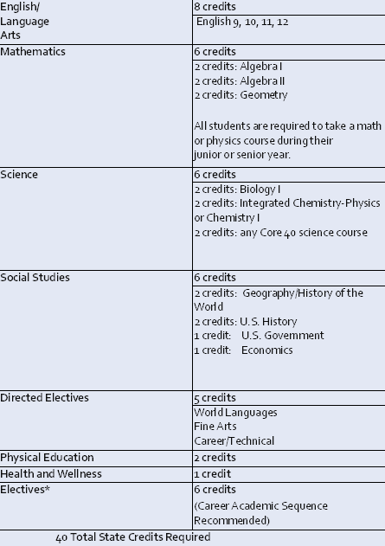
Core 40

Slide 9
Core 40 with Academic Honors
(Minimum 47 credits)
For the Core 40 with Academic Honors Diploma, students must:
Complete all requirements for Core 40
Earn 2 additional Core 40 math credits
Earn 6-8 Core 40 world language credits
Earn 2 Core 40 fine arts credits
Earn a grade of C or better in courses that will count toward the diploma
Have a grade point average of B (3.0) or better
Complete one of the following:
Earn 4 credits in 2 or more AP courses, and take corresponding AP exams
Earn 6 college credits in dual credit courses
Complete a combination of AP (2 credits) and dual credit (3 credits)
Earn a combined SAT score of 1750 or higher and a minimum score of 530 on each (critical reading, math, and writing)
Earn a 26 or higher on the ACT (including the writing section)

Slide 10
Core 40 with Technical Honors
(Minimum 47 credits)
For the Core 40 with Technical Honors, students must:
Complete all requirement for the Core 40 diploma
Earn 6 credits in career preparation courses and either get a certification or take 6 dual credits
Earn a grade of C or better in all of the courses that count toward the diploma
Earn a grade point average of B (3.0) or better
Complete one of the following:
One of the additional requirements for earning the Academic Honors Diploma
Take the Accuplacer and receive minimum scores of Writing 80, Reading 90, Math 75
Take the Compass and receive minimum scores of Writing 70, Reading 80, Algebra 66

Slide 11
ISTEP Testing
All 9th graders will take the ISTEP (Biology)
All 10th graders will also take the ISTEP (English & Math). Passing this 10th grade ISTEP test is a part of the graduation requirement.

Slide 12
How To choose high school classes
Video: How To Choose High School Classes

Slide 13
Scheduling

Slide 14
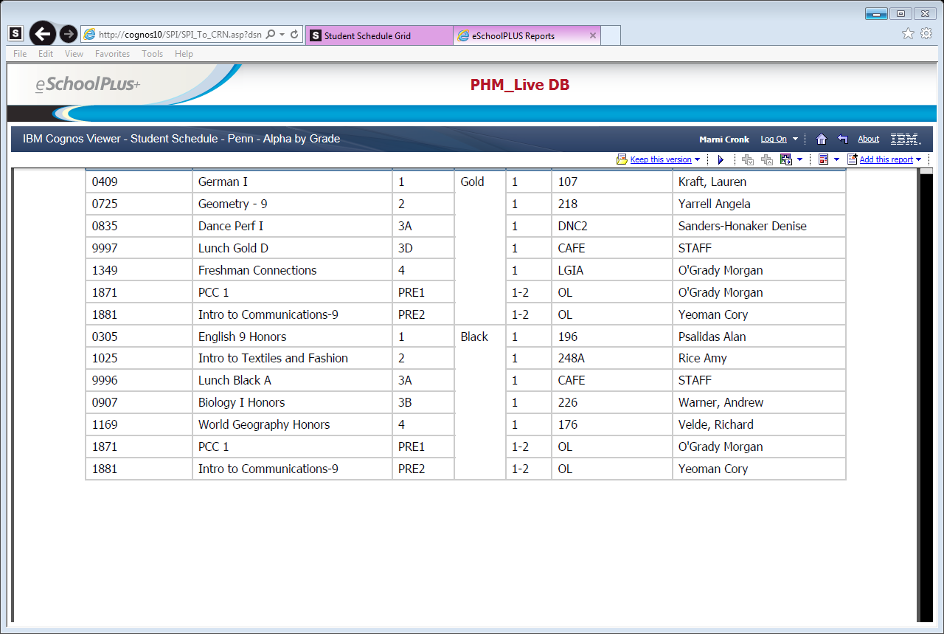
Sample Schedule

Slide 15

Honors Classes

Slide 16
English 9 Honors, Biology Honors,
World Geography Honors
These courses are rigorous Pre-AP courses. Students should have A’s or high B’s in their core subjects. (Suggestion: if you are in doubt talk to your current teacher)
Students should be strong readers and able to understand fairly complex material. Concepts are in depth and comprehensive.
Students should have a strong work ethic and desire to take an honors course.

Slide 17
Math Level Placement
Math 8 (Pre-Algebra) -> Algebra I
Grades of D or below in Math 8 and/or D.N.P. ISTEP should also take Algebra Lab
Algebra I/Algebra IB -> Geometry 9 Accelerated
Grades of B- or below should not move onto the next level and should retake the 8th grade class as a freshman.
Geometry -> Algebra II Honors
Algebra I grade must be an A or B to move onto Algebra II Honors
Algebra II -> Pre Calculus Honors (Pre AP-Pre Calculus/Trigonometry)
Must have an A in Algebra II H or should repeat in 9th grade

Slide 18


Freshman Course descriptions
All course descriptions are located online in the Program of Studies.
Program of Studies

Slide 19




Choose your classes carefully

Slide 20
Electives
Choose elective in which you think you may be interested in
Do NOT choose electives because your friends are choosing them (you will probably not be in the same class anyway)
Elective choices are NOT guaranteed☹
Make sure you choose alternates that you are interested in taking because we often have to use your alternate classes.

Slide 21
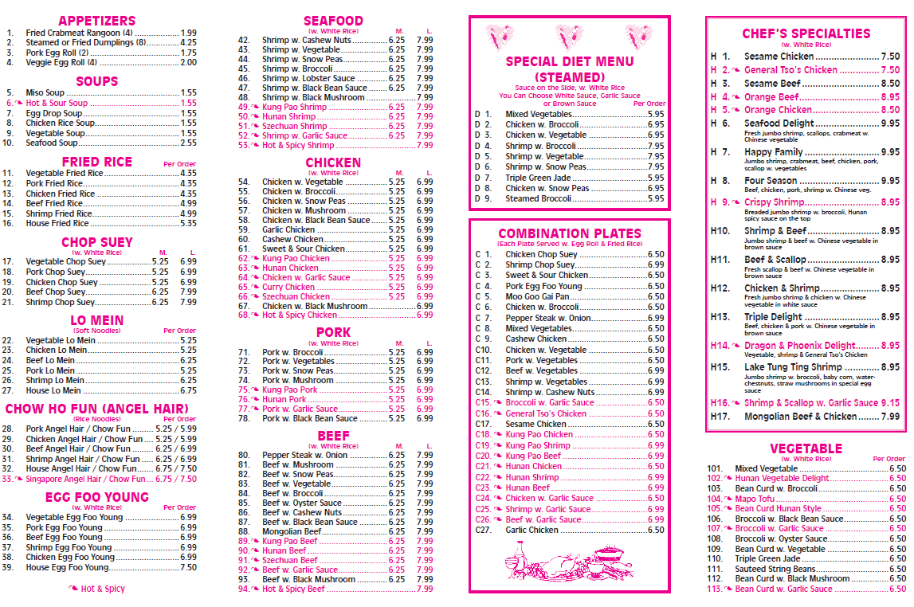
Course Menu

Slide 24



Summer School - PE
Must attend both sessions
Session 1: June 12-30
Session 2: July 10-28
In addition to daily attendance at Penn, there is an online component that must be completed (iPE).
Students can pick up the summer PE registration form in their middle school guidance office.
Registration form and money is due to the Penn bookstore by January 13, 2017. It can be delivered in person or by mail.

Slide 25




Sign up for classes in HAC
Be sure you know your HAC info.
Discovery & Grissom counselors request you enter your classes in HAC and they will double check your entries when you meet individually.
(Schmucker counselors will schedule you in HAC during your individual meeting.)
English 9 (Honors)
Math (Honors)
Biology (Honors)
Geography (Honors)
PE (summer PE)
Foreign Language (?)
Elective
Freshman Connection

Slide 26
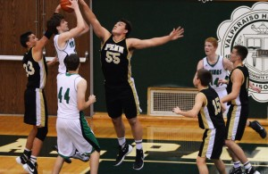
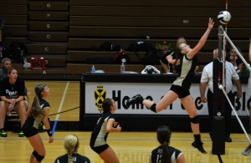
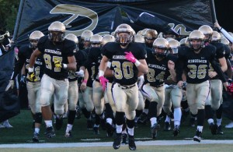
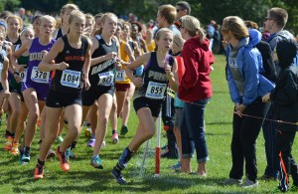
Get Involved in Extracurricular Activities
Clubs and Organizations
Powderpuff Football
Quiz Bowl
Rugby
Pep Band
Ski Club
Spanish Club
Student Council
STEM club
Dream Commission Society
Academic Super Bowl
Big Brothers/Big Sisters
Chess Club
Dramatics Club
Fellowship of Christian Athletes
German Club
Freshman Mentoring
Key Club
Penn Medical Club
Art Club
Habitat for Humanity
Intramural Basketball
Intramural Volleyball
Knowledge Master
Mock Trial
Model U.N.
National Honor Society
Computer Club
Book Club
Kingsmen Against Cancer

Slide 27
Review
Middle school Evening with parents
Penn High School Showcase
Choose your classes carefully
Do your personal best
Get involved
Turn your scheduling form into your middle school counselor by December 23

Slide 28

Enjoy the rest of your school year!
Time to meet the Mentors for a tour of the building and Q & A.

